Slide 1
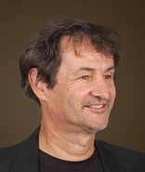
Jointly Minimizing the Expected Costs of Review for Responsiveness and Privilege in E-Discovery
Volume 37, Issue 1, Article 11 (November, 2018)
Douglas W. Oard, University of Maryland (USA)
oard@umd.edu
Fabrizio Sebastiani, CNR (Italy)
fabrizio.sebastiani@isti.cnr.it
Jyothi K. Vinjumur, Walmart (USA)
jyothi.keshavan@gmail.com

Slide 2
Document Review for E-Discovery
Employ a reasonable process to:
Identify documents that are relevant (i.e., “responsive”) to a request
Among the relevant documents, identify those that are privileged
3 possible actions:
Produce (i.e., disclose) documents that are relevant and not privileged
Enter on a Privilege Log documents that are relevant and privileged
Withhold documents that are not relevant

Slide 3
Idea #1: Finite Population Annotation
Automatic
Classifier
Manual Review
Quality
.
Manual Effort

Slide 4
Idea #1: Finite Population Annotation
Semi-Automated Classification
Automatic
Classifier
Quality
Manual Review
.
Manual Effort
Berardi, Esuli, Sebastiani: Utility-Theoretic Ranking for Semiautomated Text Classification. ACM TKDD, 2015

Slide 5
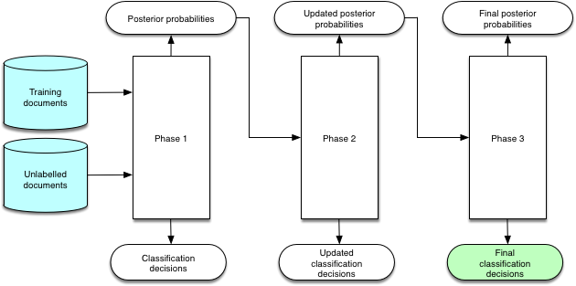
Idea #2: Two Manual Review Stages
Automatic
Classification
Manual
Relevance
Review
Manual
Privilege
Review

Slide 6
Idea #3: Task-Based Misclassification Cost
Correct Decision
 | Produce | Log | Withhold
Produce |  | $600 | $5
Log | $150 |  | $3
Withhold | $15 | $15
Prediction
√
4

Slide 7
Expected Misclassification Cost
Cost Per Mistake
Correct Decision
 | Produce | Log | Withhold
Produce |  | $600 | $5
Log | $150 |  | $3
Withhold | $15 | $15
Expected
Number of Mistakes
Prediction
Correct Decision
 | Produce | Log | Withhold
Produce |  | 100 | 5
Log | 10 |  | 1
Withhold | 5 | 1
Expected
Misclassification Cost
Prediction
Correct Decision
 | Produce | Log | Withhold
Produce |  | $60,000 | $25
Log | $1,500 |  | $3
Withhold | $75 | $15
Prediction
$61,618

Slide 8
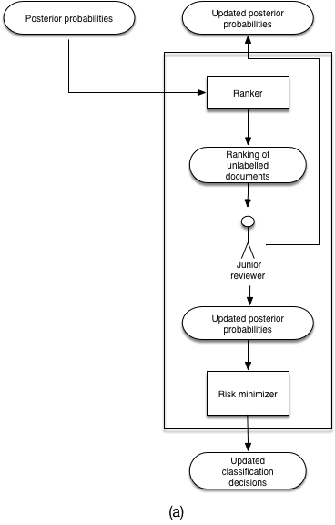
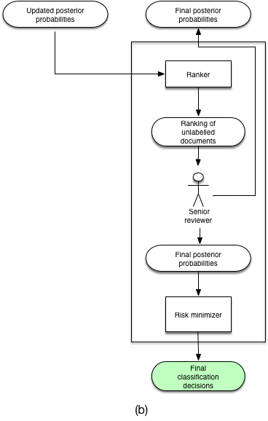
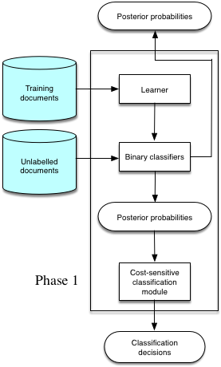
Relevance Review
Automatic Classification
Privilege Review
(Platt scaling)
Risk-Sensitive
Ranker
Risk-Sensitive
Ranker
λª_{r} = $1/doc
λª_{p} = $5/doc
Rank by Expected Reduction in Total Cost

Slide 9
Evaluation
Test Collection
Reuters RCV1-v2 (news stories)
Mod-Apte training-test partition (23K train, 200K test)
120 category pairs
24 categories each represent relevance (3% to 7%) [e.g., M12: Bond Markets]
For each, 5 other categories represent privilege (1% to 20%) [e.g., E21: Government Finance]
Automatic Classifiers
Linear-kernel SVMs for relevance and privilege
Standard term weights for this collection (tfidf:ltc, stemmed, stopped)
Manual review
Simulated as perfect judgments (using ground truth)
Evaluation measure
Expected Total Cost: manual annotation cost + misclassification cost

Slide 10
Average Improvement Over Baselines
Increase in cost over our “Risk Minimization” Cascade
 | Fully Automatic | Fully Manual | Uncertainty Ranking | Active Learning Uncertainty Sampling | Relevance Ranking | Active Learning Relevance Sampling
Case 1 | +29% | +235% | +47% | +47% | +52% | +52%
Case 2 | +2% | +893% | +10% | +4% | +11% | +7%
Case 3 | +0% | +2,416% | +0% | +0% | +0% | +0%
Lowest Privilege Error Cost
$150 (>> $5)
$10 (> $5)
$1 (< $5)
Same amount of manual annotation as Risk Minimization

Slide 11
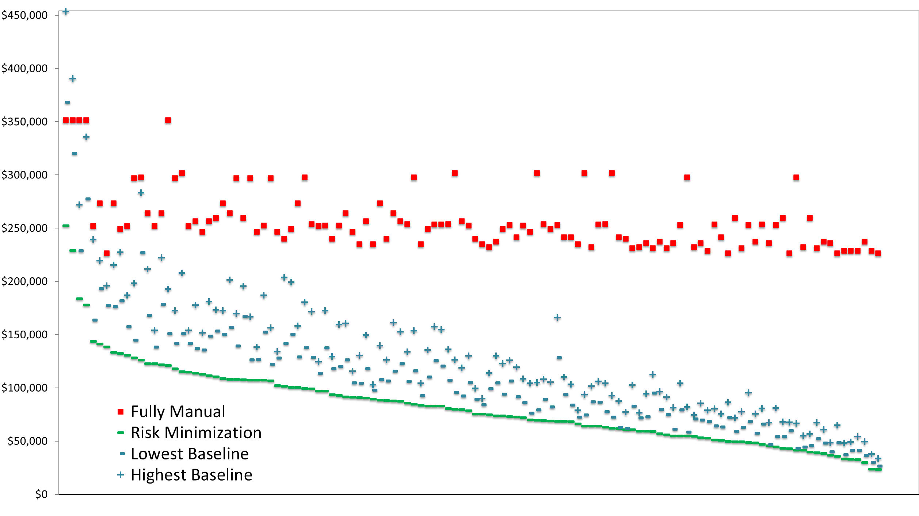
Total Cost by Topic Pair: Case 1

Slide 12
Concluding Remarks
Manual review can improve finite population annotation
Cost-sensitive classification benefits from a risk-minimizing review order
The risk-minimizing order depends on cost models and error models
We have shown results for a 3 linear cost models
Two-stage review (relevance, then privilege) requires two review orders
Optimal privilege review order benefits from improved relevance estimates
Our results rely on two simulations
RCV1-v2 news story categories as models for relevance and privilege
Perfect ground truth as a model for manual annotation
This material is based upon work supported by the U.S. National Science Foundation under Grant Nos. 1065250 and 1618695. Any opinions, findings, and conclusions or recommendations expressed in this material are those of the authors and do not necessarily reflect the views of the National Science Foundation.

